Slide 1

Computer Merit Badge
Christ The King Troop 45
Jose Remon
jremon@compunetLTD.com
With Permission from:
Tom Foss & Chris Strauss
Updated March 2010

Slide 2
Requirements
Discuss with your counselor the tips for online safety.
Give a short history of the computer. Explain how the invention of the computer has affected society, science, and technology.
Do the following:
  Describe four uses of computers outside the home.
  Describe three ways you and your family could use a personal computer other than for games and entertainment.
Explain the following to your counselor:
  The five major parts of a computer.
  How text, sound, pictures, and video files are stored in a computer's memory
  How file compression works and how compression affects the quality of the file.
  Describe two computer chip-based devices, and describe how they are "smarter" because of the chip and its program.
Do the following:
  Explain what a program or software application is and how it is developed.
  Name three programming languages, and describe their uses.
  Name four software packages you or your family could use, and explain how you would use them.

Slide 3
Requirements
  Discuss ways you can help protect a computer from viruses and how to protect the information stored on a computer.
  Describe how computers are linked to generate and access the Internet and the World Wide Web.
Do THREE of the following:
  Using a spreadsheet program, develop a food budget for a patrol weekend campout.
  Using a word processor, write a letter to the parents of your troop's Scouts inviting them to a court of honor.
  Using a computer graphics program, design and draw a campsite plan for your troop.
  Using a computer graphics program, create a flier for an upcoming troop event, incorporating both text and some type of visual such as a photograph or illustration.
  Using an Internet search engine (with your parent's permission), find ideas about how to conduct a troop court of honor or campfire program. Print out a copy of the ideas from at least three different Web sites. Share what you found with your counselor, and explain how you used the search engine to find this information.
  Using a presentation software program of your choice, develop a report about a topic that has been approved by your counselor. For your presentation, create at least 10 slides.

Slide 4
Requirements
  Using a digital camera, take a picture of a troop activity. Transfer the picture file to a computer and use photographic software to make it small enough to send easily as an e-mail attachment. Then, using a computer connected to the Internet (with your parent's permission), send an e-mail to someone you know. In your message, include the photograph as an attachment. Verify that the person received your e-mail and was able to view the attachment.
  Using a database manager, create a troop roster that includes the name, rank, patrol, and telephone number of each Scout. Show your counselor that you can sort the register by each of the following categories: rank, patrol, and alphabetically by name.
Do ONE of the following:
  Using a database program of your choice, create a troop roster that includes the name, rank, patrol, and telephone number of each Scout. Create a form within the database manager to access each Scout's information individually. Show your counselor how the form works.
  Using a software package of your choice for computer aided design (CAD), create an engineering-style drawing of a simple object. Include the top, bottom, and at least one side view and the dimensions.

Slide 5
Requirements
  Create a blog and use it as an online journal of your Scouting activities, including group discussions and meetings, campouts, and other events. Your blog should have at least five entries and two photographs or illustrations. You need not post the blog to the Internet, but you will need to share it with your counselor. If you decide to go live with your blog, you must first share it with your parents AND counselor and get their approval.
  Create a Web page for your troop, patrol, school, or place of worship. Include at least three articles and two photographs or illustrations. Your Web page should have at least one link to a Web site that would be of interest to your audience. You need not post the page to the Internet. However, if you decide to do so, you must first share it with your parents AND counselor and get their approval.
  Visit a business or an industrial plant that uses computers. Observe what tasks the computers accomplish, and be prepared to discuss what you have learned.
Explain the following to your counselor:
  Why copyright laws exist
  Why it is not permissible to accept a paid, copyrighted computer game or program
  from a friend unless the game or program is considered freeware or shareware. Explain the concepts of freeware and shareware.
  The restrictions and limitations of downloading music from the Internet
Find out about three career opportunities in the computer industry. Pick one and find out the education, training, and experience required for this profession. Discuss this with your counselor, and explain why this profession might interest you. Report what you learn to your counselor.

Slide 6
1 - Tips for Online Safety
Never give out or post personal information on the Internet, such as your address, telephone number, the name or location of your school, or your parents' names.
Never, under any circumstances, agree to meet face-to-face someone you have corresponded with online without your parent's permission.
Never respond to messages or bulletin boards that are sexually obscene, threatening, or make them feel uncomfortable in any way.
Never send any personal materials to an online friend, such as an address, telephone number, or photograph, without first informing your parents.
Always be reminded that the people you meet online may not be who they say they are.
Be aware of cyberbullies. If you feel you are the victim of a cyberbully, do not retaliate. In a private message, calmly ask the cyberbully to stop and let the bully know that you will take other steps if the abuse does not stop. Tell your parents or guardian right away.
Always inform your parents when you come across anything online that makes you uncomfortable.

Slide 7
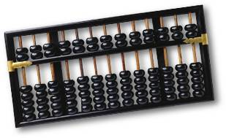
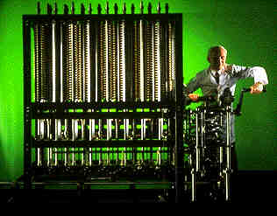
2 - History of the Computer
Analog vs. Digital
Abacus – Early
Difference Engine -1888

Slide 8
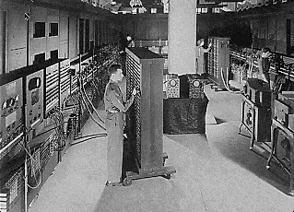
Early Digital Computers – ENIAC - 1945

Slide 9
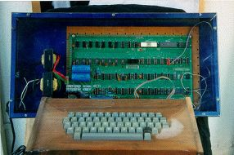
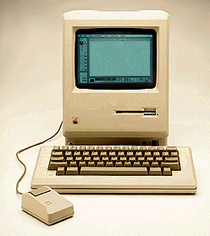
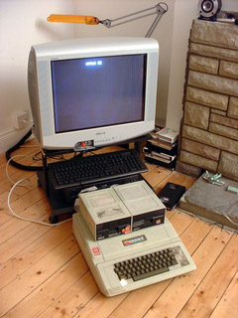
Apple 1 – 1975/Apple ][ - 1977
Macintosh - 1984

Slide 10
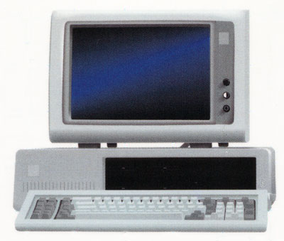
IBM PC - 1981

Slide 11

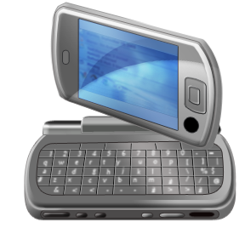

Last 20 Years
Explain how the invention of the computer has affected society, science, and technology.

Slide 12
3 - Uses of computers outside the home
Calculation
Word Processing
Communications
Web Portals
Analysis

Slide 13
Home Uses of Computers
Email
Family Web Pages
Accounting
Bill Paying
Research
…

Slide 14
4 - Parts of a Digital Computer
Input
Output
Processor
Memory
  ROM
  RAM
Storage
  Hard Drive
  USB Drive
  DVD Drive

Slide 15
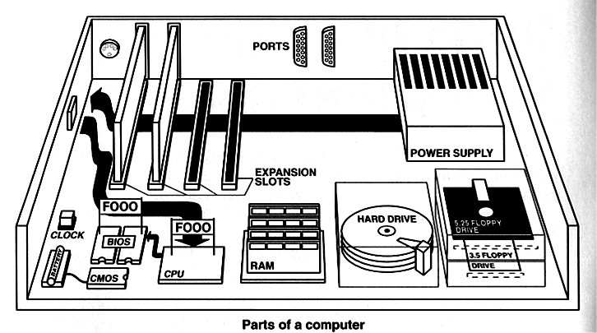
Schematic Diagrams

Slide 16
Input Devices (digitizers)
Keyboard
Mouse and other Pointing devices
  Trackball, joystick, pressure-sensitive tablet, touch screen – a location digitizer
Sound digitizer (microphone, MIDI device)
Scanner (an image digitizer)
Sensor (temperature, light, moisture, smoke, movement, or digitizer)

Slide 17
Output Devices
Printers (the first output device) and Plotters
  Impact (daisywheel) and dot-matrix
  Thermal (early BW and color)
  Laser (highest quality, BW and color)
  Plotters (pens on moving arms like seismographs)
  Ink-jet (color plotters lead to printers, some also thermal)
Monitor
  Analog: CRT (cathode-ray tube) – the “monitor”
  Digital: LCD (liquid-crystal display) screens
Sound Card (digital to analog converter)
Modem (modulator-demodulator; another digital to analog signal converter)

Slide 18
Processor & Memory
Central Processing Unit (CPU) is the “brain,”
and is some brand of microprocessor chip
The CPU is normally mounted in a plug-in socket on the motherboard, a circuit board tying everything in the computer together via an electronic “bus”
Co-processors are used to offload computing tasks from the CPU, such as mathematics and graphics
Random Access Memory (RAM) and Read-Only Memory (ROM) are also mounted here
  ROM is permanent, often re-writable (CMOS)
  RAM is transient unless permanently powered (Palm)

Slide 19
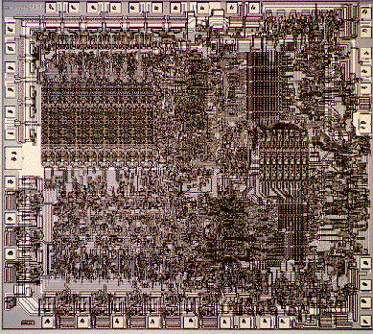
8080 – 1975 - 4500 Transistors

Slide 20
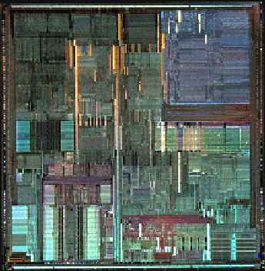
Pentium Pro – 1995 – 5.5 Million

Slide 21
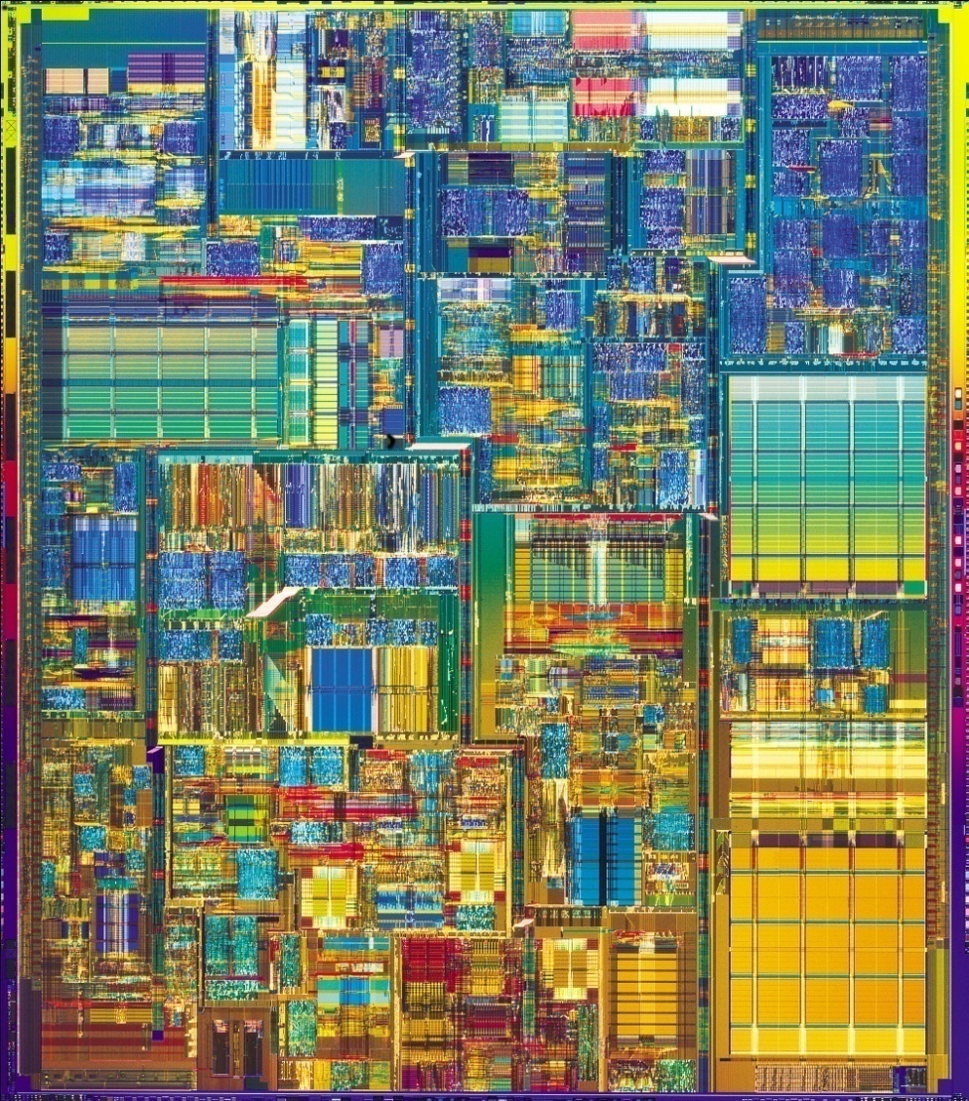
Xeon – 2009 – 721 Million

Slide 22
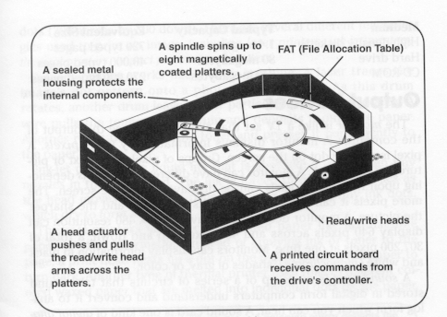
Magnetic - Digital Storage
Sequential Access
  Magnetic Tape
    Backup tapes
Random Access
  Hard Disk
    Magnetically coated metallic platters on high-speed spindle
    Drive actuator with many floating read-write heads on arms
Digital Storage
    USB drives, memory cards – SD, CF, SM
    Can be shared across devices, ie PCs, games, cameras
    Flash memory is a type of EEPROM chip, which stands for Electronically Erasable Programmable Read Only Memory

Slide 23
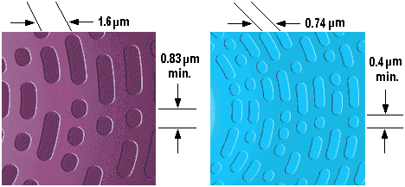
Optical Storage
CD-ROM (Compact-Disc Read-Only Memory)
  Write laser burns pits into the surface of the disk
  Read laser bounces light off the pitted surface
  WORM – Write Once Read Many, or CD-R
  Newest formats: CD-RW, DVD, DVD-RW
Capacity (newer media have higher capacities)
  Compare the CD-ROM surface (left) to the DVD surface (right)
  CD – Up to 800 MB/DVD – Up to 9 GB/BluRay – Up to 50 GB

Slide 24
Output Devices
Printers (the first output device) and Plotters
  Impact (daisywheel) and dot-matrix
  Thermal (early BW and color)
  Laser (highest quality, BW and color)
  Plotters (pens on moving arms like seismographs)
  Ink-jet (color plotters lead to printers, some also thermal)
Monitor
  Analog: CRT (cathode-ray tube) – the “monitor”
  Digital: LCD (liquid-crystal display) screens
Sound Card (digital to analog converter)
Modem-Network Card-Broadband Wls

Slide 25
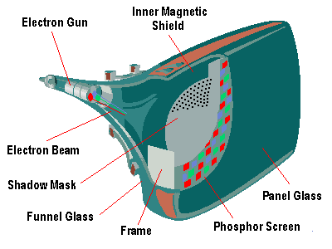

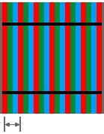
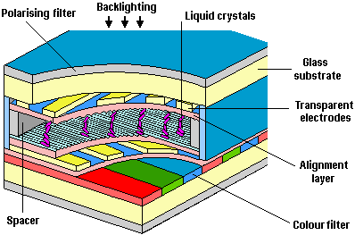
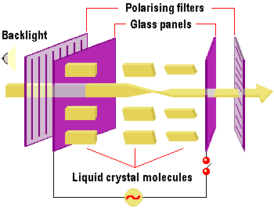

CRT-LCD Display
CRT
  Dot Trio
  Aperture Grill
  Slotted Mask
  Enhanced Dot Pitch
LCD

Slide 26
Text, sounds, pictures and Video
  Digitizing – the process of creating a digital representation of an image or sound
  Pixel = picture element
  Representations of this type are always approximations

Slide 27
Binary representation of text
  Binary coding schemes
  ASCII:
    Uses 8 bits (= one byte) for each character
    Enough for 256 different combinations
  UNICODE:
    A superset of ASCII
    Uses 2 bytes for each character
    Enough for 65,536 different combinations

Slide 28
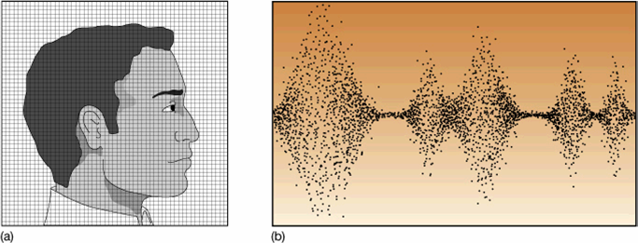
Data Storage

Slide 29
Data Storage: Text & Numbers
Computers use binary numbers (1’s and 0’s) to store data. One digit is a bit; four are a nibble, eight are a byte. Integers (whole numbers) can be stored directly in binary bytes.
  0 = 00000000 3 = 00000011
  1 = 00000001 4 = 00000100
  2 = 00000010 5 = 00000101
A byte can be translated into a decimal number by adding up the decimal values indicated by “1’s” in the binary number
  128 64 32 16 8 4 2 1 decimal values
  0 0 0 0 0 0 0 0 binary places (8-bit)
  0 0 1 0 1 0 1 0 binary equals 42 decimal (32+8+2)
Additional translation schemes have been developed to match character sets to decimal and binary, such as ASCII & EBCDIC

Slide 30
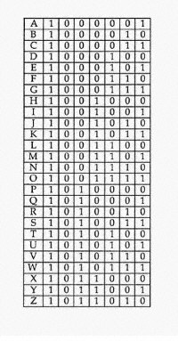
Data Storage: Text & Numbers
Text and numeric characters are stored as ASCII (American Standard Code for Information Interchange ) values, consisting of 128 different decimal codes. Extended ASCII goes to 256 codes.
ASCII translates each letter and number into a binary byte (8 bits) that the computer understands.
  "1" is ASCII decimal “49” and binary 00110001
  "A" is ASCII decimal “65” and binary 01000001
  “&” is ASCII decimal “38” and binary 00100110
  “z” is ASCII decimal “122” and binary 01111010

Slide 31
ASCII Translation
ASCII Decimal | ASCII Binary | Alphanumeric
2 | 1000010 | B
18 | 1001111 | O
26 | 1011001 | Y
20 | 1010011 | S
3 | 1000011 | C
18 | 1001111 | O
22 | 1010101 | U
21 | 1010100 | T
20 | 1010011 | S

Slide 32

Data Storage: Pictures
Computer pictures are stored as millions of colored dots
called “pixels” (picture elements) that have to be translated
to an analog signal for an analog CRT monitor to display them (LCD panels are already digital so no translation is required).
Each black & white pixel is either on or off; each color pixel is three dots, Red, Green, and Blue (RGB) that combine to create a color. Color pixel combinations range from 256 possible colors to over 16.8 million colors (real, or true color).
The more pixels a picture has, the better it looks (it has a higher resolution). Each pixel has an associated color and location on the screen expressed in binary terms.
When stored, each pixel’s information is saved to disk separately. In a true color (32 bit) pixel, 4 bytes are used to store the color information for each dot in the pixel. For a 1600x1200-pixel display this is 8-million bytes of video memory, stored as one 8mb disk file!

Slide 33
A pixel

Slide 34
Color Displays
Red
Green
Blue
Purple
Yellow

Slide 35
Color Displays
Black
White

Slide 36
Intensity - Millions of colors
Red=
255
Green=
255
128
64
128
10
Blue=
255
128
168

Slide 37
Data Storage: Sound
Normal sound is made up of waves or vibrations.
Each sound wave has a wavelength (how far between
the waves) and amplitude (how high the wave is).
A mixed, analog waveform signal comes in to the sound card from a source (microphone) and is processed in real-time by an analog-to-digital converter (ADC) circuit chip to create a binary (digital) output of 1s and 0s. This is done at a specified interval or “sampling frequency” (i.e., 1/10th of a second).
The digital output from the ADC is further processed and compressed by the digital sound processor (DSP), and the output from the DSP is sent to the computer's CPU via the sound card connections and the data bus on the motherboard.
Digital sound data is processed by the CPU and sent to the hard-disk controller to be recorded on the hard-disk drive as a wav file.
Playback is a reversal of this process, using a a digital-to-analog converter (DAC) circuit chip to play back the binary sound file.

Slide 38
Storing Sound
Sound waves are sampled at a constant rate (sample rate)
Amplitude (height) of the wave is stored.
The higher the sample rate the better the sound
The higher the sample rate the more data is stored
amplitude
Wavelength
sample rate

Slide 39
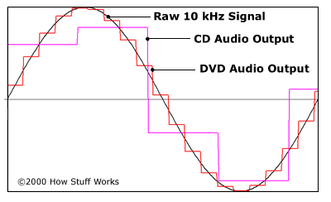
Analog to Digital
 | CD Audio | DVD Audio
Sampling Rate | 44.1 kHz | 192 kHz
Samples per second | 44,100 | 192,000
Sampling Accuracy | 16-bit | 24-bit
Number of possible Output Levels | 65,536 | 16,777,216

Slide 40
File compression
Files can be very large to download and take lots of storage space.
File compression reduces the size of a file so it can be downloaded faster or take less storage.
Compression software uses complex equations to scan a file for repeating patterns in the data.
Ex.
The cat ran across the room. (* = the)
Compressed - * cat ran across * room)

Slide 41
Computer chip-based devices
Smart phones
Ipods
Game consoles
The chips allow the device to process more information faster and the program allows the user to control and interact with the device.

Slide 42
5 – Software & Programs
Operating Systems
  Windows
  Mac OS
  Linux/Unix
Applications
  Word Processing (Word)
  Spreadsheet (Excel)
  Browser (Internet Explorer, Firefox, Safari,Chrome )
  Data Base (Access)
  Presentation (PowerPoint)
  Specialized (Accounting, Ordering,….)

Slide 43
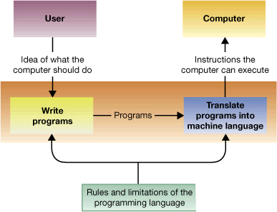
Programming As a Translation Process

Slide 44
Assembly Languages
Are automatically translated into machine language by assembler programs
Makes programs easier to write because it avoids the problem of physical references
Still very laborious and error-prone

Slide 45
Programming Languages
COBOL , Basic, Fortran (older languages)
Modern languages
C++ - General Purpose
HTML - Web Site Programming
Java – Cross platform \ Web apps

Slide 46
Software Packages & Uses
Web Browsers- IE, Safari( Surf the Web)
Word Processors- MS Word, WP (School work, Letters)
Accounting- Quick Books, Quicken (Taxes)
Entertainment- itunes, Media player (Music, Movies, Videos)

Slide 47
Security
Virus & Spyware Checkers
  Must be Updated!
  Attachments - .exe, Javascripts
Firewall hardware & software
  Port blocking
  Filtering
  Logging
Backups (Computers are unforgiving)

Slide 48
Networking & Internet
Protocol
  Ethernet
  TCP/IP (Transmission Control Protocol/Internet Protocol)
Topology
  Bus
  Star
  Wireless (802.11n/WiFi)
IP Addresses
  254.12.123.16
  Private Subnets (10.10/192.168)
  Routers

Slide 49
Network Configurations
Bus Network connected to a Star Network

Slide 50
Accessing the Internet
Dial Up
  Modem (Modulator/Demodulator)
  56K (realistically 45K)
Broadband
  Always on
  High Speed
  DSL – Cable – Fiber
  Wireless Wifi - Satellite

Slide 51
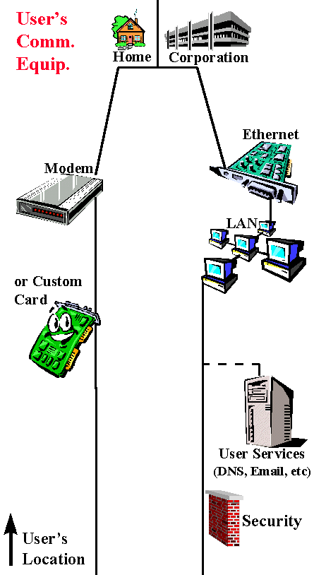
Accessing the Internet

Slide 52
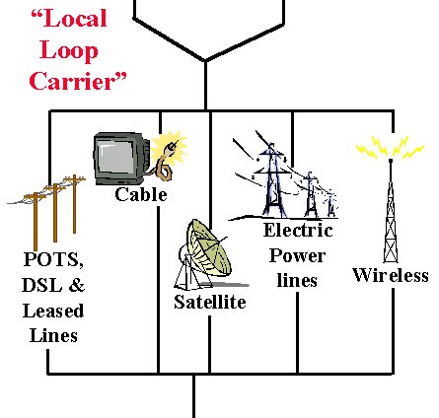
Accessing the Internet

Slide 53
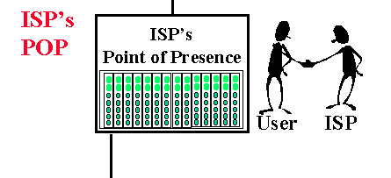
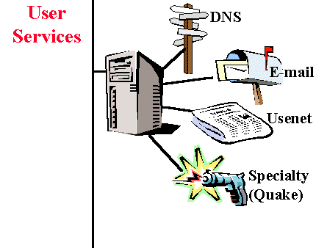
Accessing the Internet

Slide 54
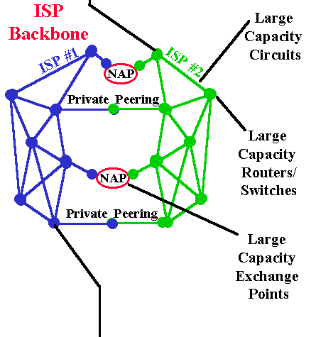
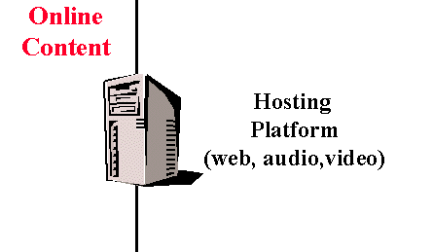
Accessing the Internet

Slide 55
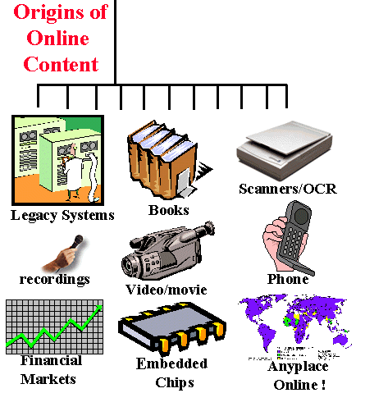
Accessing the Internet

Slide 56

6 – Do the following
Using a spreadsheet program, develop a food budget for a patrol weekend campout
Show the following Colums: Item, Number of Items, Price per Item, *Total price of Items
*Show the Total Price on the last Row
Item
2 Gallons of Milk $ 3.00 ea
4 Bag of Bread $ 1.50 ea
2 Dozen Eggs $ 1.50 ea
2 12oz Ham $ 3.00 ea
4 Tomatoes $ 1.00 ea
1 12oz Cheese $ 2.00 ea
1 5 lb Bag of Rice $ 3.00 ea
1 2 lb Bag of Beans $ 1.00 ea
2 Boxes of Jello $ 1.50 ea
* Must use formula to calculate total

Slide 57
Do the following

Slide 58
7 - Do the following
  Using a word processor, write a letter to the parents of your troop's Scouts inviting them to a court of honor.
  Using a database program of your choice, create a troop roster that includes the name, rank, patrol, and telephone number of each Scout. Create a form within the database manager to access each Scout's information individually. Show your counselor how the form works.
HOMEWORK
  Using a digital camera, Find a picture from a Scout activity. Transfer the picture file to a computer and use photographic software to make it small enough to send easily as an e-mail attachment. Then, using a computer connected to the Internet (with your parent's permission), send an e-mail to someone you know. In your message, include the photograph as an attachment. Verify that the person received your e-mail and was able to view the attachment.
  Visit a business or an industrial plant that uses computers. Observe what tasks the computers accomplish, and be prepared to discuss what you have learned.
  Email the picture to someone you know or myself: jremon@compunetLTD.com

Slide 59

8 - Copyright/Ethics
Copyright
  US & International Law
Licensing Types
  Commercial
  Freeware
  Shareware
Copying & Sharing Commercial Content is Wrong!

Slide 60
Downloading Music \ Movie
Content publishers have always taken pains to protect their intellectual property.
  Most content is covered by copyright, meaning that it cannot be copied or downloaded without special permission from the author or without payment to the company.
  Most commercial software packages have elaborate licensing agreements, much more like leasing than buying
  Shareware, freeware, banner ware, ad ware, and open-source software are all variations on the licensing of software
  Public-domain software is not copyrighted, and is free to be copied and used
  Downloading or Sharing Music \ Movies for free is the same as stealing from a local store, unless when allowed by law.
  There have been many convictions of users and companies due to copyright violations.

Slide 61

9 - Jobs in Computers
Hardware Engineer
Programmer \Web Site Designer
Systems Integrator
A person or company that specializes in bringing together component subsystems into a whole and ensuring that those subsystems function together, ie Network Systems
Education: Information Technology (IT) degree,
Training: Private companies certifications, ie Microsoft, HP, Dell Systems Engineer.
Experience: Normally 3 years working with computers and networks.

Slide 62
Q & A
Are there any question about any of the topics covered.
Thank you.

